Slide 1
CRC
class
responsibility
collaborator
CRC (Class Reponsibility Collaborator) cards are "low tech": ordinary index cards

Slide 2
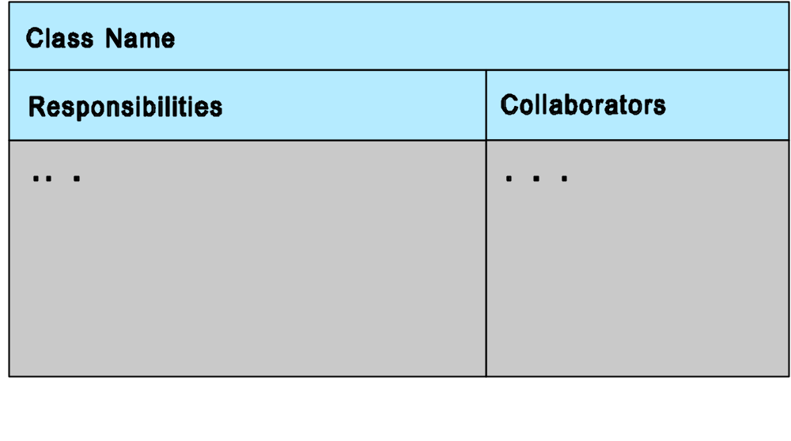

Slide 3
Key idea: objects have responsibilities, as if they were simple agents (or actors in scenarios)
Each object is responsible for specific actions client can expect predictable behaviors
Responsibility also implies independence: to trust an object to behave as expected is to rely upon its autonomy and modularity

Slide 4
Candidate class - CRC card
Lecturers
appointments
students
availability slots
day
week
reception
lecturer
appointment
student
availability_slot
day
week
reception

Slide 5
CRC card - format (FRONT)
Class:
Base:
Derived:
responsibilities
collaborators

Slide 6
CRC card - format (BACK)
Description:

Slide 7
Class
Promote all of the nouns in the candidate class list to CRC cards.
Some of them may be thrown away in the subsequent discussion.
New classes may be added latter.
Use BASE and DERIVED fields to hold inheritance information.

Slide 8
responsibility
What is each class responsible for knowing.
What is each class responsible for doing.

Slide 9
collaborator
Consider each responsibility in turn
Decide whether the class under discussion fulfils the responsibility itself, or whether it get help from another class.

Slide 10
ATM Problem CRC cards
1.Class ATM - with component parts:
1.Class CardReader
2.Class Display
3.Class Keyboard
4.Class CashDispenser
5.Class EnvelopeAcceptor
6.Class ReceiptPrinter
7.Class OperatorPanel

Slide 11
ATM Problem CRC cards
2.Class Session
3.Class Transaction - with subclasses:
1.Class WithdrawlTransaction
2.Class DepositTransaction
3.Class TransferTransaction
4.Class InquiryTransaction
4.Class Bank

Slide 12
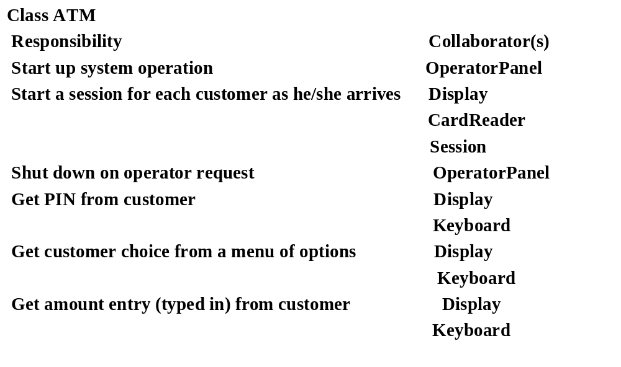
ATM Problem CRC cards

Slide 13
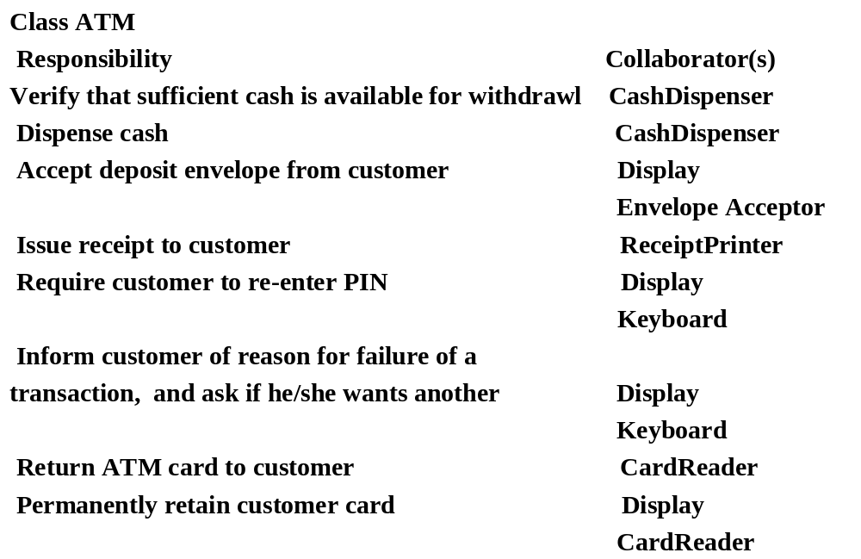
ATM Problem CRC cards

Slide 14
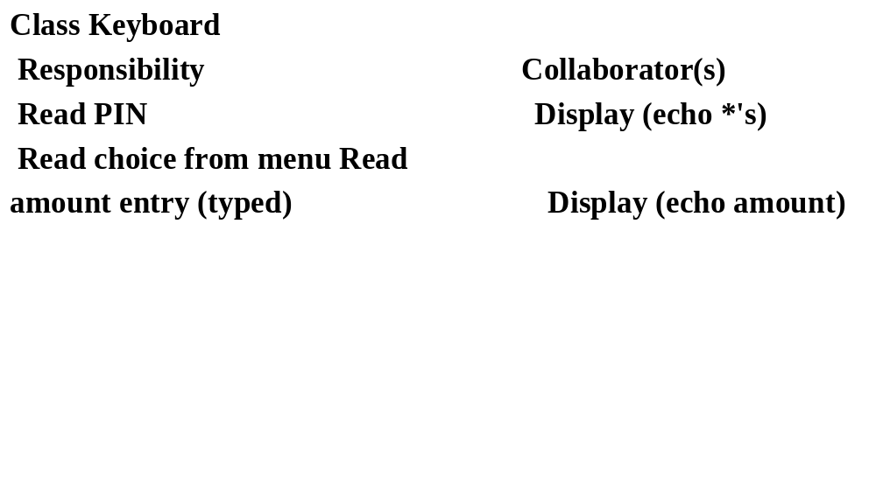
ATM Problem CRC cards

Slide 15
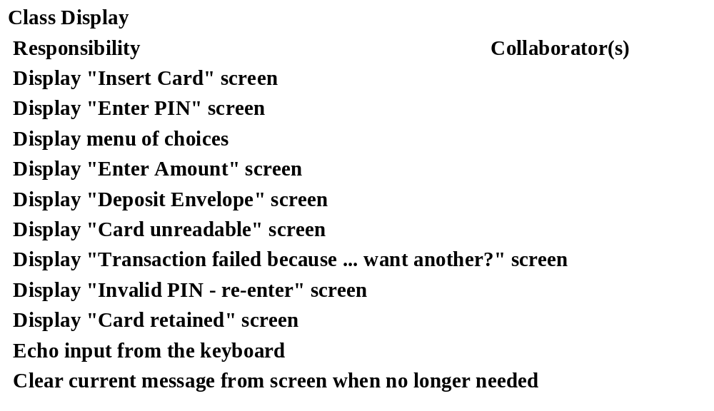
ATM Problem CRC cards

Slide 16
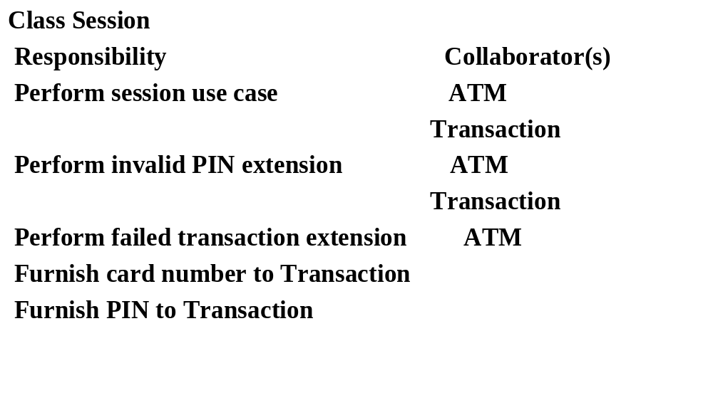

Slide 17
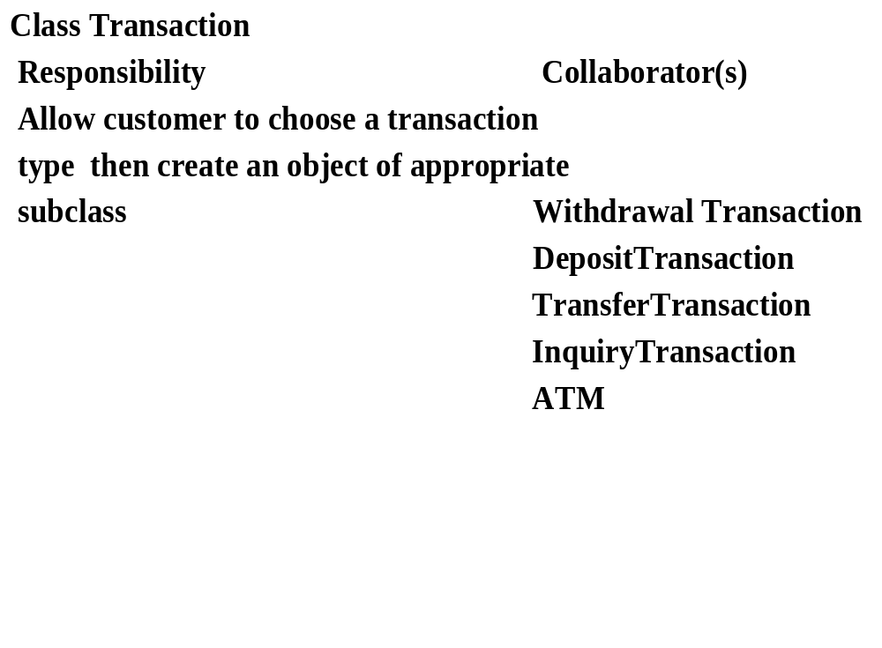

Slide 18
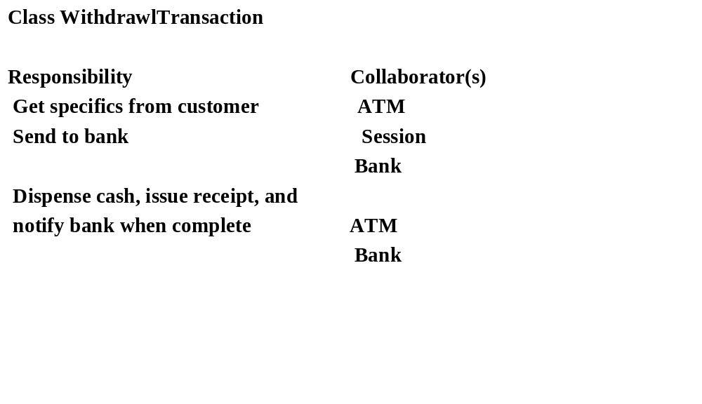

Slide 19
ATM Example System Class Diagram

Slide 20
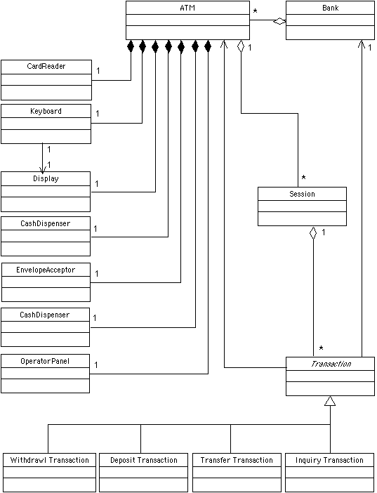
Receipt printer

Slide 21
Do a detailed reading of Pressman chapter 19 and 20

